Slide 1
Data Analysis and Insights for Ride Sharing Service 2021 - 2022 (Casual vs Member Analysis )

Slide 2
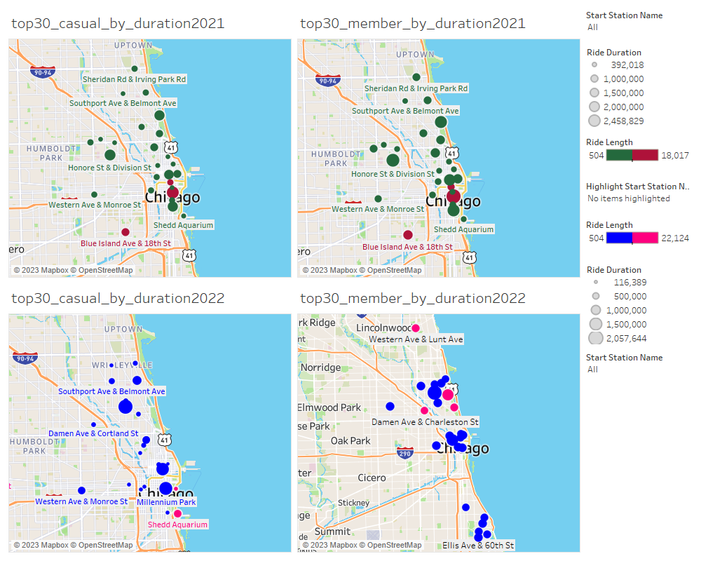
Location based Ride Duration and Length Between Casual Riders and Members
Location Patterns: Casual riders mainly start downtown, while member riders have more spread-out locations.
Yearly Changes: Casual riders shift towards Millennium Park in 2022; member rider locations remain steady

Slide 3
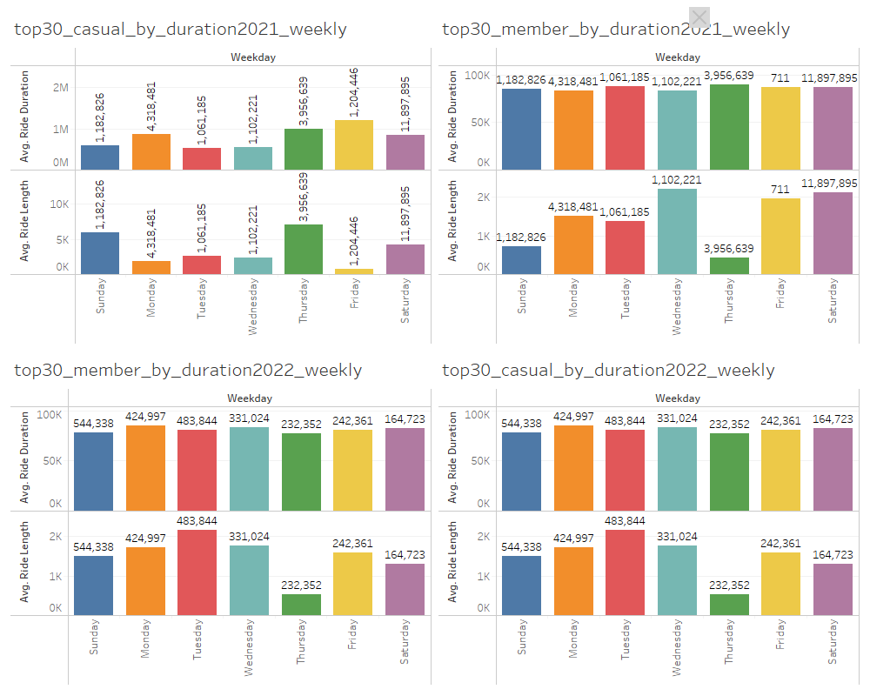
Avg Ride Duration and length Between Casual Riders and Members (Weekly)
Weekly Patterns: Casual riders peak on weekends, while member riders show consistent usage throughout the week.
Ride Duration: Casual riders have more variability in ride length, whereas member riders maintain stable durations.

Slide 4
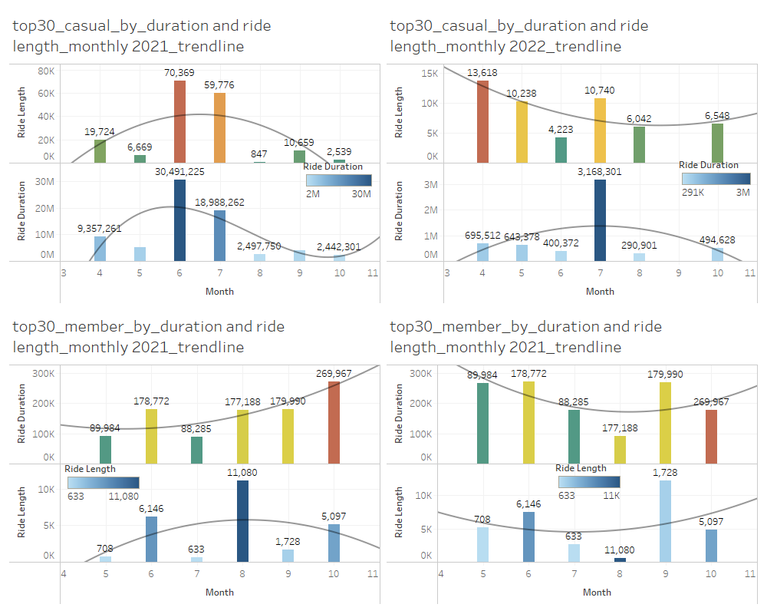
Monthly Trend
Monthly Patterns: Casual riders peak in mid-2021 and early 2022, while member riders are more consistent, peaking in October 2021.
Trends: Casual riders show high mid-year variability, whereas member riders maintain steady year-round usage.

Slide 5
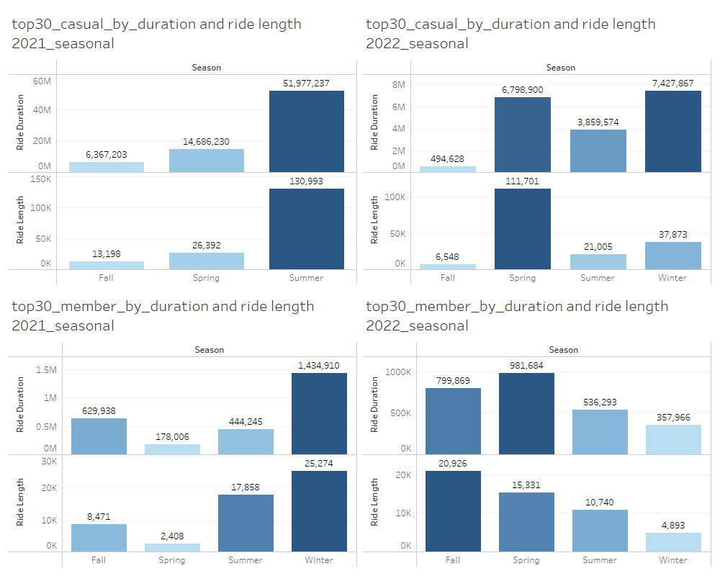
Impact of Seasonality between Members and Casual Riders (2021 - 2022)
Seasonal Ride Patterns: Casual riders peak in summer, while members show consistent usage year-round with spikes in winter (2021) and spring/fall (2022).
Yearly Comparison: Casual riders' activity decreased from 2021 to 2022, whereas member riders maintained stable ride patterns, indicating a more loyal and consistent user base.

Slide 6
Visuals
Location Patterns (2021 and 2022)
Top 30 Casual and Member Riders by Duration (2021 and 2022 by Location):
Casual riders mainly start downtown, shifting towards Millennium Park in 2022.
Member riders have more evenly distributed start locations across the city.
Weekly Ride Patterns (2021 and 2022)
Top 30 Casual and Member Riders by Duration (2021 and 2022 Weekly):
Casual riders peak on weekends.
Member riders show consistent usage throughout the week.
Monthly Ride Patterns (2021 and 2022)
Top 30 Casual and Member Riders by Duration and Ride Length (2021 and 2022 Monthly):
Casual riders peak in June-July 2021 and April 2022.
Member riders are consistent with slight peaks in October 2021 and stable patterns in 2022.
Seasonal Ride Patterns (2021 and 2022)
Top 30 Casual Riders by Duration and Ride Length (2021 and 2022 Seasonal):
Casual riders peak in summer 2021 and spring 2022.

Slide 7
Conclusion
From the figures presented, several key observations can be made:
Seasonal and Monthly Patterns: Casual riders peak in summer (2021) and early spring (2022), while member riders show consistent usage with slight peaks in winter (2021) and spring/fall (2022).
Weekly and Location Patterns: Casual riders peak on weekends with high variability in ride length, mainly starting downtown, especially around Millennium Park in 2022. Member riders show consistent ride patterns throughout the week with evenly distributed start locations.

Slide 8
Recommendations
From the figures presented, several key observations can be made:
Offer downtown incentives for casual riders to become members.
Promote services in high-traffic areas like Millennium Park.
Increase bike availability and docking stations in popular areas.
Continuously analyze start location trends to optimize bike placements and service efficiency.

